Slide 1
Voronica MCU Configuration
Manta M8P V1.0

Slide 2
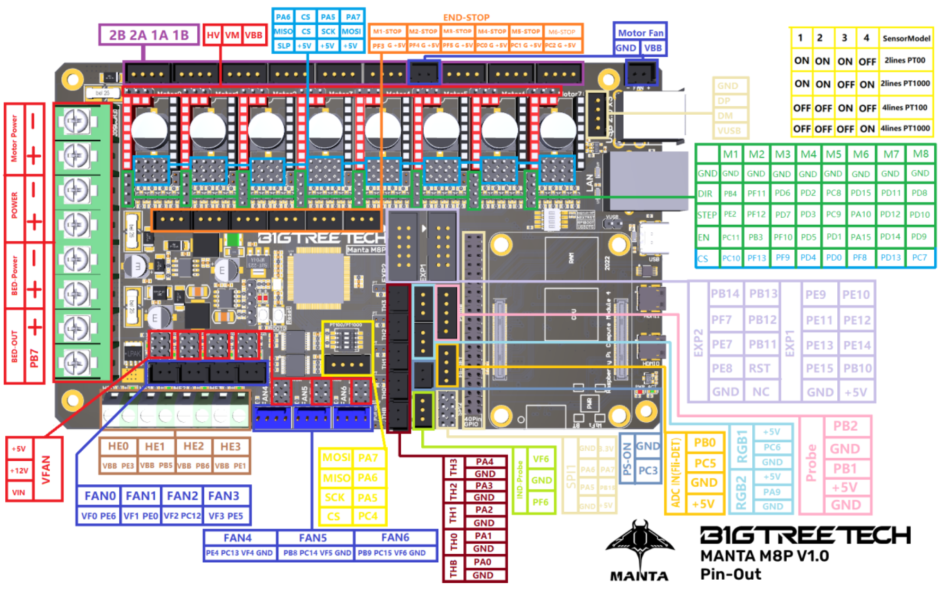
X
Y
TAP
Z
X
X
Y
E
Z0
Z1
Z2
Z3
X-Stop
Y-Stop
Tap (z)
Z-Stop
TH-SB
CASE
TH-HE
TH-part
NEO Pixels
RGB1
TH0
THB

Slide 3
Steppers / Drivers General Info
Parts source: West3D
V2.4 LDO Motor Kit
BTT TMC2226 Driver (x7)
Motors
E – Axis (1x) StealthBurner CW2 mod
LDO-36STH20-1004AHG(XH)
NEMA14 36mm pancake motor
X – Y Axis (2x)
LDO-42STH48-2004MAH(VRN)
Z – Axis (4x)
LDO-42STH48-2004AC(VRN)
Stepper Drivers
BTT TMC2226 v1.0
interface: UART
equivalent to: TMC2209
TMC2226 Trinamic Datasheet

Slide 4
E-Axis Config
MCU Motor Pin header: 3A (3B not used)

Slide 5
End Stops
X – Axis
pin: PF3
Y – Axis
pin: PF4
Z – Axis (DO NOT USE)
Added end-stop but don’t need b/c using the ”Voron Tap”
pin: PF5
Voron Tap (Z-Axis)
pin: PC0

Slide 6
Klipper Configuration
Follow these guides to get the printer.cfg setup:
Voron 2.4 docs – Mini12864 LCD Display Klipper wiring and config
Voron 2.4 docs – Software Configuration
Voron-Tap Klipper configuration
Mods and config varients
Klipper NeoPixel Templates
Obico – Klipper Camera
Calibration procedures to run
HotEnd/Toolhead: PID_CALIBRATE
Voron-tap:
PROBE_CALIBRATE
TIP: Before calibrating, switch to the spray coated spring steel sheet side
need to manually calibrate the probe’s Z offset
probe_accuracy samples=100
Heat soak the machine and then run a bunch of times
See 7. Voron-Tap Post-Install Setup
Quad gantry leveling: QUAD_GANTRY_LEVEL

Slide 7
Voron-Tap Post-Install Setup
Update your printer.cfg as recommended in Tap Klipper Instructions
Home Z and test virtual Z endstop by lifting tool-head
Heat soak your machine and run a couple probe_accuracy samples=100 to "break-in" your probe
Run a few more probe_accuracy checks (default of 10 probes)
For well-built machines you can expect to see between 0.0000 and 0.0008 standard deviation.

Slide 8
Heat Soaking
Forum posts
How are you determining heat-soak duration, and for how long?

Slide 9
Links
BTT Manta M8P Resources
BTT TMC 2226 Stepper drive datasheet
Other:
TMC2209 Pin Out (FYSETC)
BTT TMC 2209 Datasheet
TMC2226 Datasheet
Keenovo build plate heating mat
Hotbed thermistor NTC 100k datasheet
R-T Table Sheet
VoronTap Klipper configuration guide
Klipper Rotation Distance Calculator

Slide 10
Backup / Scratch starts here
2/19/23

Slide 12
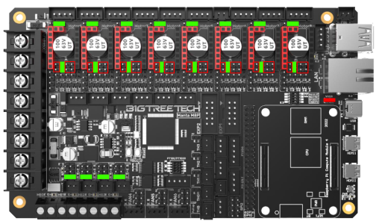
https://forum.vorondesign.com/threads/manta-m8p-diagrams-for-trident-and-v2-4.48/

Slide 13
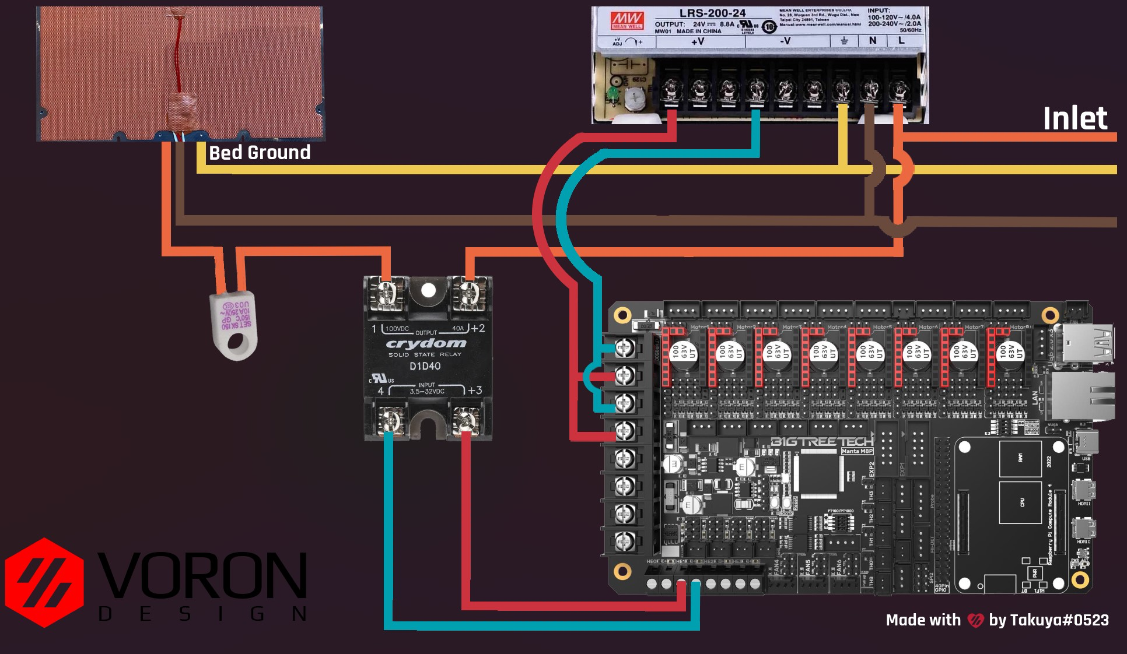
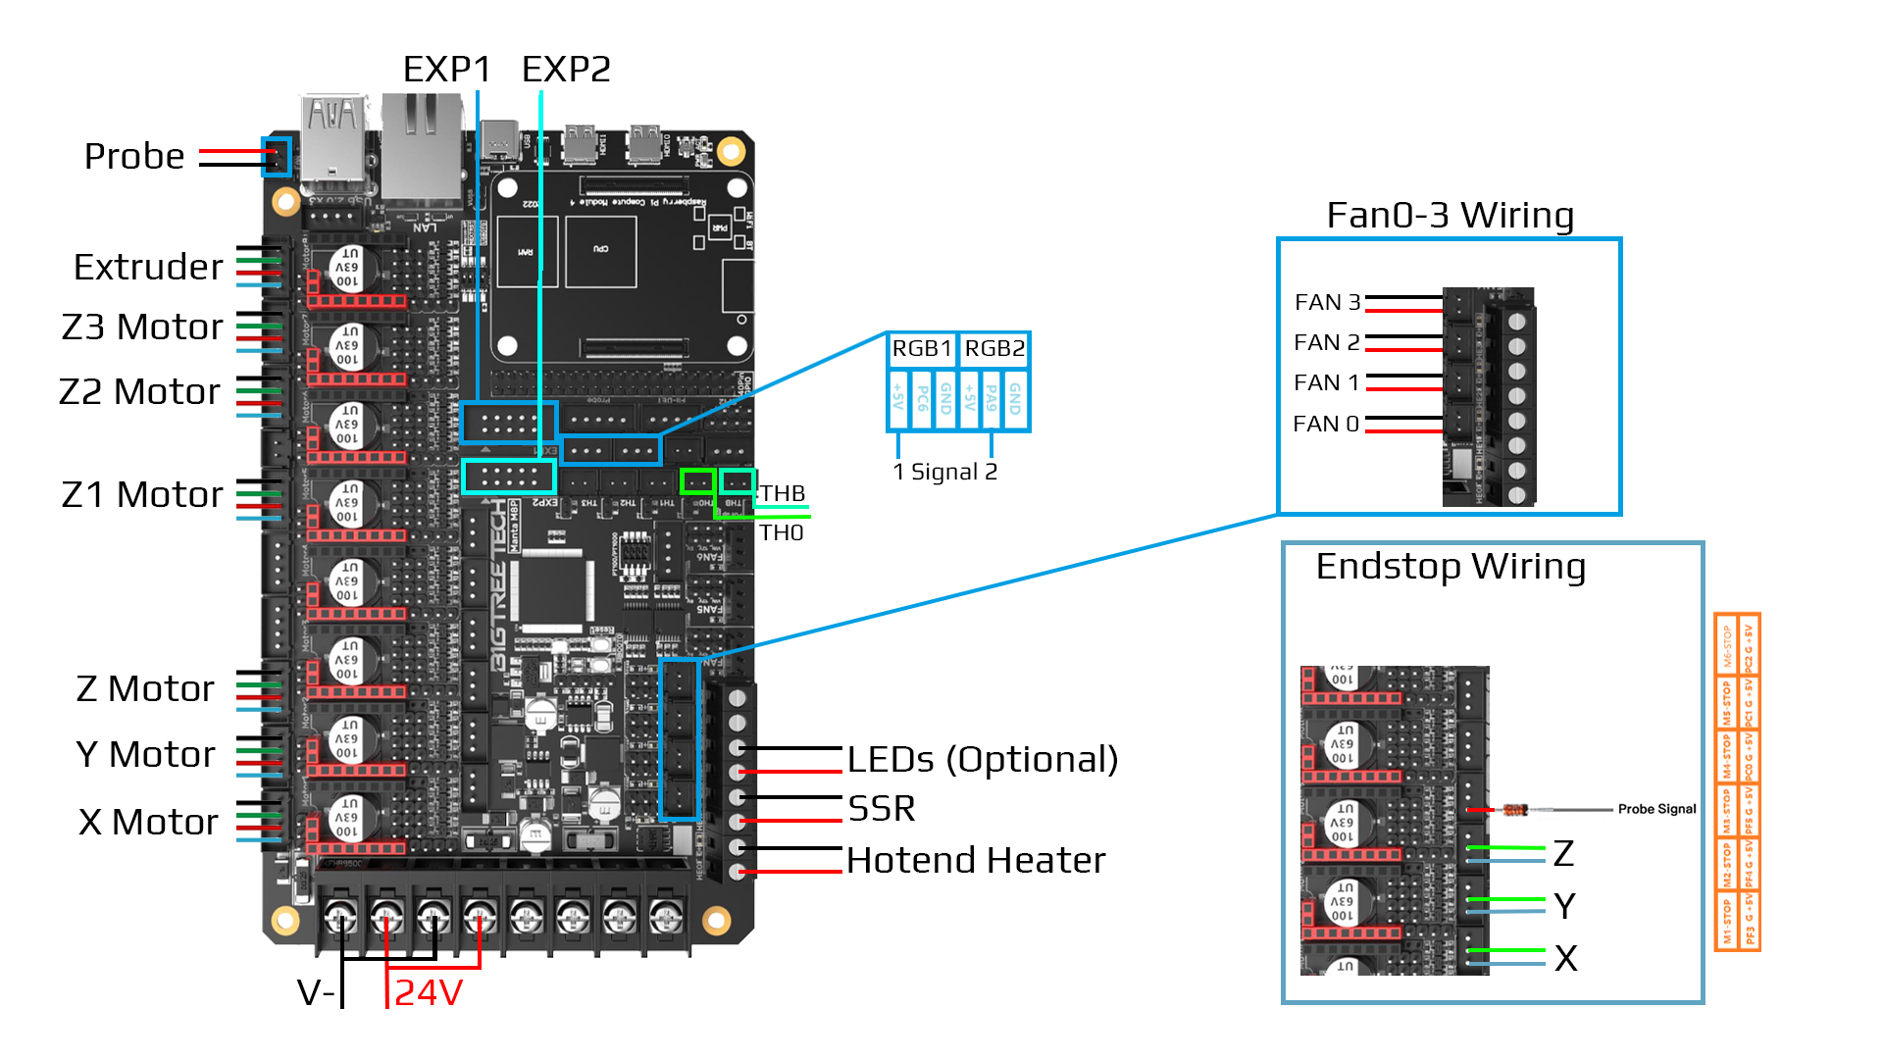
https://forum.vorondesign.com/threads/manta-m8p-diagrams-for-trident-and-v2-4.48/

